Slide 1



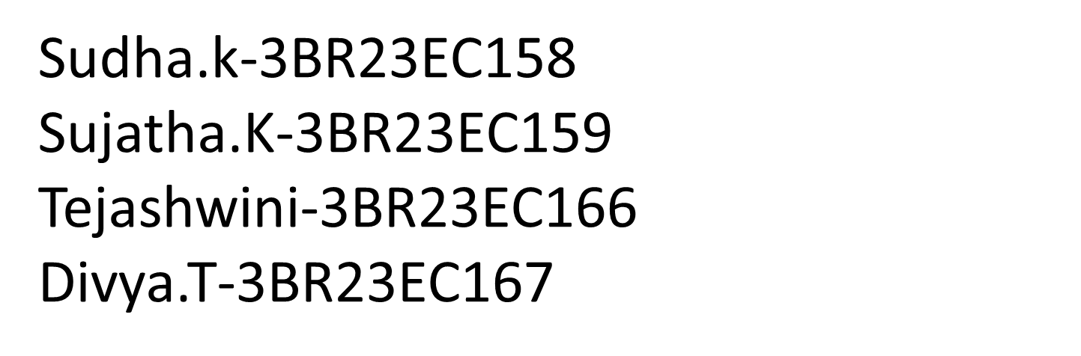
VIRTUAL TICKETING SYSTEM
class

Slide 2
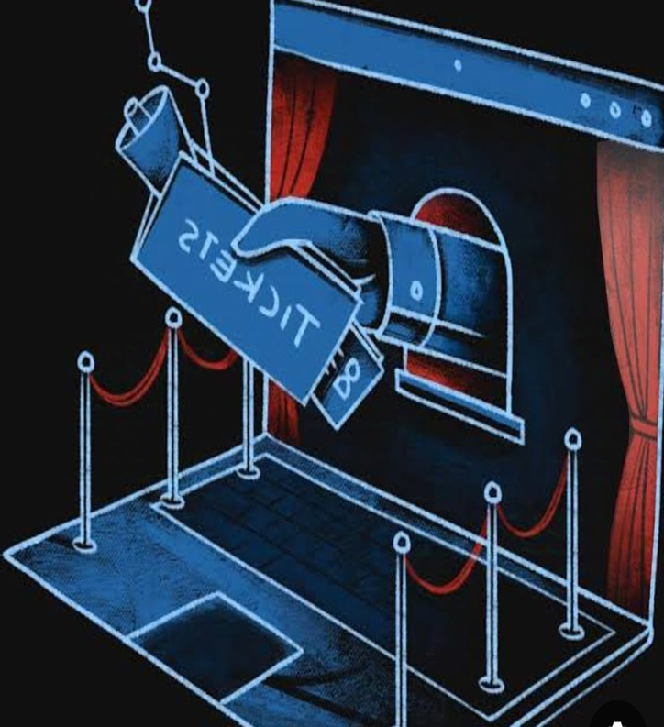
INTRODUCTION
A Virtual Ticketing System is a Digital Platform that enables users to purchase, manage, and access tickets for events , transportation , or services in a conveninent , secure, and efficient manner . This System eliminates the needed for physical tickets , reducing costs and minimizing the environmental impact associated with printing and distribution.

Slide 3


PROBLEM STATEMENT
Mobile Access
Secure & Scalable
Attendees can conveniently access their tickets on their smartphones, eliminating the need for physical tickets.
Virtual ticketing platforms are designed to handle large volumes of tickets, ensuring security and scalability.
Real-Time Analytics
Data on ticket sales, attendance, and customer behavior can be accessed in real-time, providing valuable insights.

Slide 4
OBJECTIVES
Personalized Ticket Design
Website
Marketing Materials
Create custom ticket designs that reflect your event's branding and theme.
Host your ticketing website with your brand's design and colors, enhancing customer experience.
Promote your event with branded marketing materials, such as social media graphics and email templates.

Slide 5
ALGORITHM
1
CLASSES – Ticket to represent individual tickets.
Ticket Manager to handle operations related to the tickets such as CRUD operations , sales , and validations
2
OPERATIONS - CRUD (Create , Read , Update , Delete) operations for ticket data.
Handling of online ticket sales.
3
DATA HANDLING – To keep it simple , tickets will be stored in a dictionary keyed by ‘ticket_id’

Slide 6
FLOW CHART
[Start]
|
v
[User Login?] -----> [Prompt for login] -----> [User Login]
| |
Yes No
| |
v v
[Dashboard] <-------------------
|
v
[Select: Submit/View/Generate/Logout]
|
v
[Submit Ticket] ---> [Validate Input?] -----> [Show Error] -----> [Prompt for Correction]
| |
| Yes
| |
v v
[Generate Ticket ID] [Return to Dashboard]
|
v
[Save Ticket] -----> [Display Confirmation] ---> [Return to Dashboard]

Slide 7
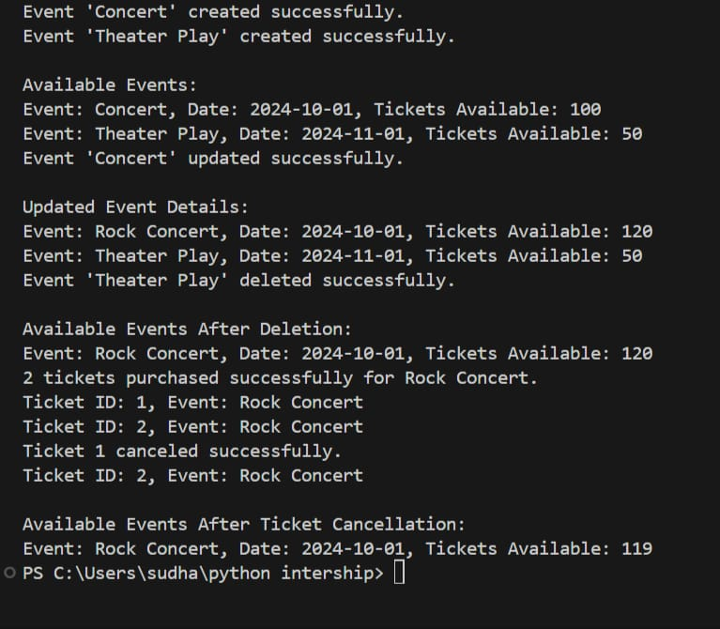
OUTPUT

Slide 8


CONCLUSION
Virtual ticketing offers a range of benefits for event organizers and attendees. Consider implementing a virtual ticketing system to enhance your event management and customer experience . A Virtual ticketing system significantly enhances user experience and operational efficiency by streamlining the processes of ticket submission , management , and resolution.

Slide 9
FUTURE ENHANCEMENT
24/7 Access : Users can purchase tickets online anytime , anywhere , without having to visit a physical location.
Mobile – Friendly : Tickets can be easily accessed and purchased via mobile devices , enhancing the user experience.
Paperless : Digital tickets cut down on the cost of printing , distribution , and handling.

Slide 10


